Slide 1

Employee Management System using SQL

Slide 2
About me :-
Name :- Disha Sudhakar Suryawanshi
Education :- G. H. Raisoni college of engineering and business management ,Jalgaon.
• Why I Want To Learn Data Science :- I want to learn data science because ,I’ve always been curious about how companies makes the decision about what customers likes or dislikes, that urge of knowing how this decision making works in companies created my interest in data science .
• Connect With Me :- LinkedIn - www.linkedin.com/in/dishasuryawanshi0104
GitHub - https://github.com/Dishasuryawanshi0104

Slide 3
Business Objectives :-
In this Project ,by Analysing the Employee Management System, uncovers how systems store and manage employee information such as personal details, job roles, qualifications, leaves and payroll data in a single database.
It improves efficiency and accuracy in managing employee records and reduce manual data handling.

Slide 4
Approach of Business Objective -
To automate payroll processing by integrating salary, bonus, and leave information.
To track employee qualifications and skills to support recruitment, promotions, and role assignments.
To manage employee leave records and analyze their impact on payroll.
To support decision-making by generating useful reports such as department-wise salary, employee count, and payroll summaries.

Slide 5
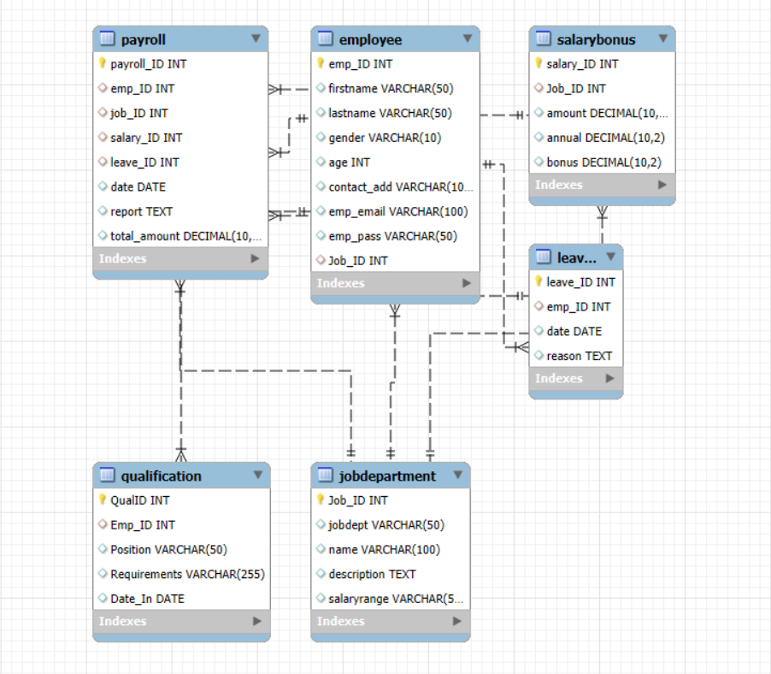
ER Diagram:-

Slide 6
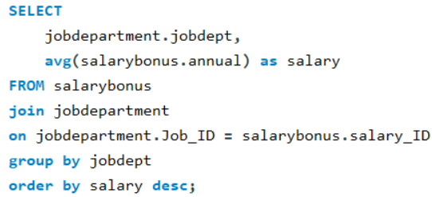
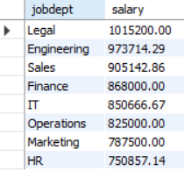
-- Average salary per department
Insights :-
Legal department has the highest average salary -
This suggests higher compensation due to specialized expertise, responsibility, and compliance-related roles.

Slide 7
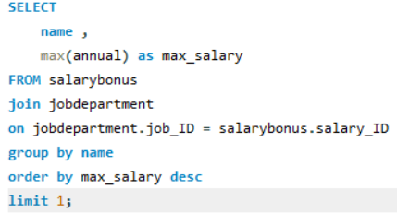

-- Job roles which offer the highest salary
Insights :-
The Finance Director role offers the highest salary among all job roles in the organization. -
This indicates that financial leadership positions are highly valued, reflecting their responsibility in managing company finances, budgets, and strategic decisions.

Slide 8
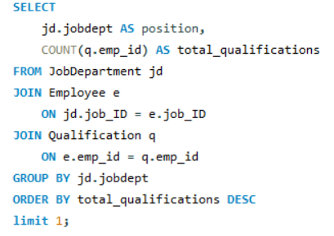

-- Employees who have the highest number of qualifications
Insights :-
The Finance position has the highest number of qualifications among all roles. -
Roles in Finance likely involve complex responsibilities such as financial planning, risk management, compliance, and auditing, which demand stronger academic and professional backgrounds.

Slide 9
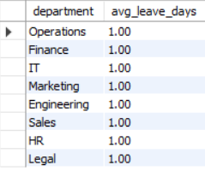
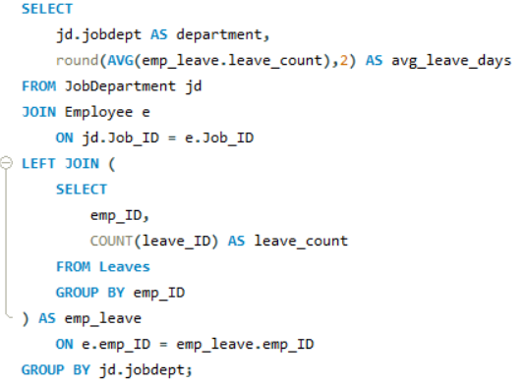
-- Average number of leave days taken by its employees per department
Insights :-
All departments show an average leave count of 1.00 day. -
This indicates a uniform leave-taking pattern among employees in all departments.

Slide 10
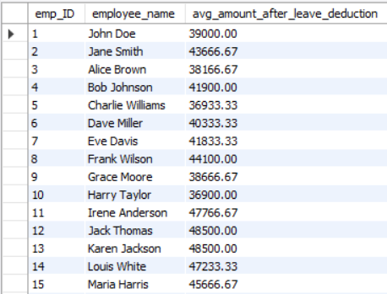
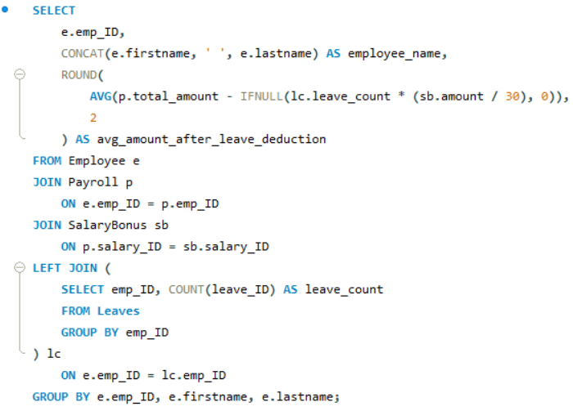
-- Average value of total amount of employee after considering leave deductions
Insights :-
The average payable salary after leave deductions varies across employees, indicating differences in salary structure and leave impact. -
Overall, the results show that leave deductions do affect final salaries, but the organization maintains a balanced payroll structure.

Slide 11
Experiences and Challenges :-
Experiences –
Gained hands-on experience in designing and implementing relational databases using MySQL.
Gained experience in error handling and debugging SQL queries .
Practiced writing complex SQL queries involving JOIN, GROUP BY, AVG, COUNT, and subqueries.
Challenges –
Designing a proper database schema and identifying correct relationships between tables
Handling foreign key constraints and maintaining data integrity
Understanding real-world business logic and converting it into SQL queries

Slide 12
Conclusion :-
The Employee Management System successfully integrates employee details, job roles, qualifications, leave records, and payroll information using a relational database.
The project demonstrates the effective use of SQL concepts such as tables, primary keys, foreign keys, joins, aggregation, and constraints.
Overall, the Employee Management System provides a reliable, scalable, and efficient solution for managing organizational employee data.

Slide 13

THANK YOU

